Slide 1
Performance of Different Models on Online Sexism Classification
Presentation By: Ryan Chien, Tony Lin, Peter Yang

Slide 2
Agenda
Introduction (competition, objectives)
Dataset/Data Exploration
Experimental Setup
Goals for Results
Notes:
Intro and background - tony
Dataset - peter
Experimental setup/goals for results - ryan

Slide 3
Introduction
CodaLab Competition
20,000 Social Media comments as Dataset
3 Tasks: A– Binary, B– Category, C– Fine-grained vectors
3 Models: XGBoost, BERT, GPT
Notes:
Online sexism has became a serious problem nowadays, and automated tools can certainly assist the detection of sexism at different scales. Therefore, to address this issue, we introduce SemEval Task 10 on the Explainable Detection of Online Sexism (EDOS).
2. equal amounts of data from Reddit and Gab. For each platform, we first create a pool of 1M entries. We then sample 10k entries from each pool for labelling

Slide 4
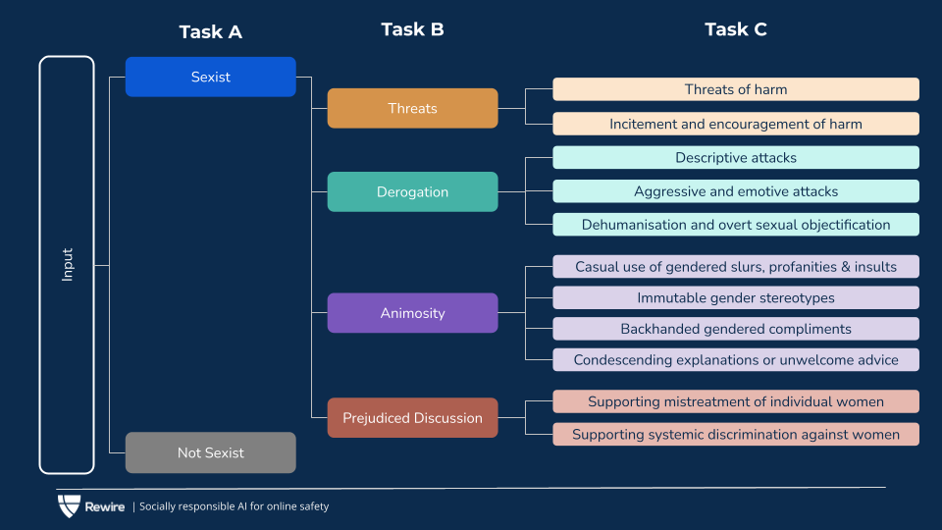
Objectives

Slide 5
Dataset/Data Exploration
Data collection
Gab (34M posts), Reddit (42M comments)
Sample 1M entries from each platform
Sample 10k cleaned entries from each for 11 fine-grained sexism vectors
Notes:
Peter
A large portion of online harms research had already gathered data from Twitter, so the researchers of this paper decided to use two social media platforms, Gab and Reddit, to produce a diverse dataset.
With 34M Gab posts and 42M comments on Reddit, they randomly sampled 1M entries from each platform, and sampled 10k cleaned entries from each at the end for 11 fine-grained sexism vectors.

Slide 6
Dataset/Data Exploration
Data preparation and sampling
Cleaning
Boosted sampling
Keyword search/lexicons
Community-based/user-based sampling
Notes:
Peter
For data preparation, they cleaned the text in the Gab and Reddit pools to make sure that the entries have neither personal information nor text that is not in English. After the cleaning was done, they applied their sampling techniques, including keyword search or lexicons, and community-based or user-based sampling. They also used other more complicated sampling methods to prevent having biases.

Slide 7
Dataset/Data Exploration
Data annotation
Annotator recruitment
Annotation process
Notes:
Peter
For data annotation, they worked with trained annotators who all self-identify as women, and each entry was labeled by three annotators. To ensure label quality, they have an expert team consisted of two women authors of this paper and two of the most experienced workers from the annotation team to give labels for cases with less than 3 agreement in Task A and less than 2 agreement in Tasks B and C.

Slide 8
Dataset/Data Exploration
Dataset distribution
Training 70%
Development 10%
Test 20%
Notes:
Peter
The data was split into training, development, and test sets in the ratio of 70:10:20. Only sexist instances are included in Task B and C.

Slide 9
Experimental Setup
Train 3 models on the training dataset
Calculate accuracy for each model for the 3 tasks on the development set and test set

Slide 10
Model 1: XGBoost (Extreme Gradient Boosting)
Iteratively train a series of decision trees, where each subsequent tree focuses on correcting the mistakes made by the previous trees (form of ensemble methods)
XGBoost uses gradient boosting, which means it minimizes a loss function by calculating the gradients of the loss with respect to the model's predictions
This boosting process aims to gradually reduce the overall prediction error and improve the model's accuracy

Slide 11
Model 2: BERT (Bidirectional Encoder Representations from Transformers)
Transformer neural network capable of understanding bidirectional context by utilizing self-attention
Usually pre-trained and fine-tuned on a large corpus of text
For this project, we will be pre-training BERT on the sexist and non-sexist comments provided in the dataset
BERT generates word embeddings that are contextualized representations
Helps BERT understand language nuances and better perform NLP downstream tasks

Slide 12
Model 3: GPT (Generative Pre-trained Transformer)
Transformer neural network designed specifically for generating human-like text (ChatGPT)
Similarly to BERT, GPT also utilized self-attention
Suitable for tasks such as text completion, summarization, story generation, etc.
GPT generates text in an autoregressive manner, meaning it predicts one word at a time based on the previously generated words.
This allows GPT to maintain coherence and produce coherent and contextually relevant sentences.

Slide 13
Goals
Quantitative: we hope to achieve above the baseline accuracies provided in the paper for each task
Task A: 0.4933%, Task B: 0.2297%, Task C: 0.0811%
Qualitative: we want to explore the dataset and hopefully identify certain features that better identify sexist and non-sexist comments

